Slide 1
W/C 11 September 2023
Assembly - Key Messages
Diverse in Ambition, United in Success

Slide 2
Key Messages
Student Absence Procedure
Safeguarding
Prevent
British Values
QR Survey
Preparation for academic success
Final Points/Reminders

Slide 3
Student Absence Procedure
If students are ill or have an emergency, they are required to email before 9:00 AM to inform them of the reason for absence and expected return date.
studentabsence@newvic.ac.uk
A message will be put on ProMonitor to inform all relevant staff.
Two authorised absences per term.
Must complete an online absence request via ProPortal.
Evidence must be provided/conversation with your tutor before an authorised absence is approved.

Slide 4
How to submit a Student Absence
Request Guide

Slide 5
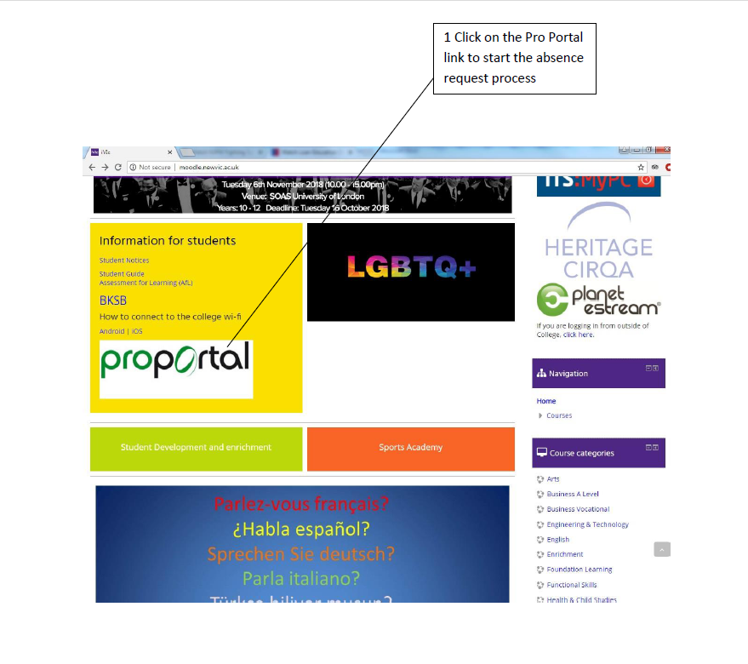

Slide 6
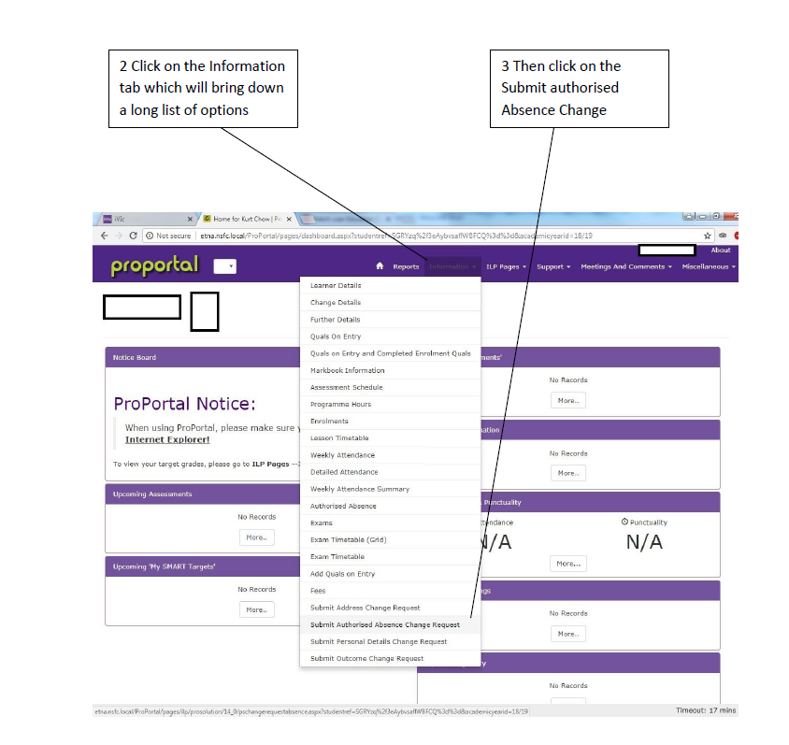

Slide 7
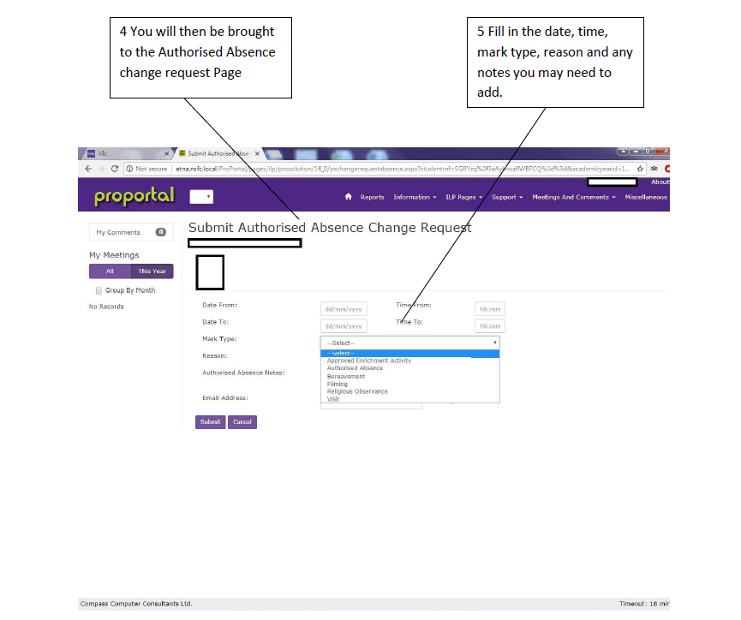

Slide 8
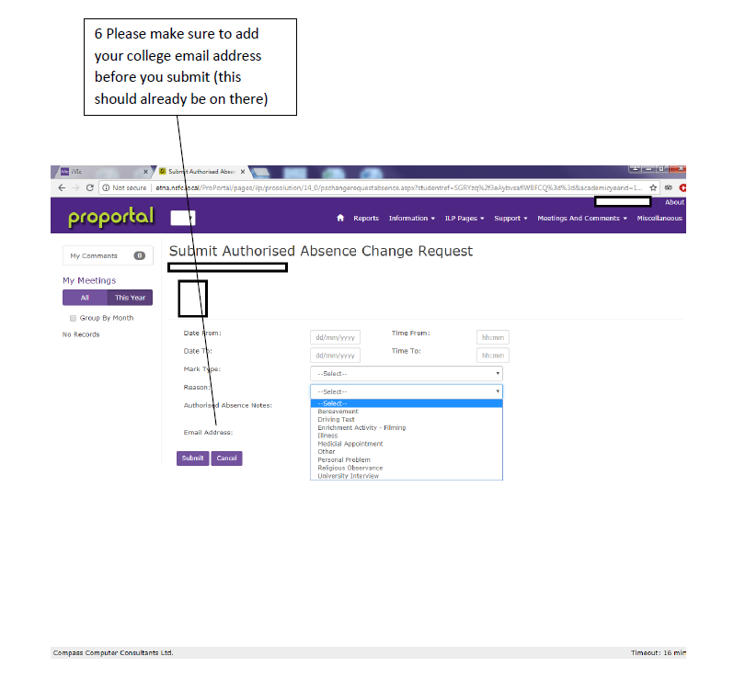

Slide 9
Safeguarding
Child Protection
Recognising abuse and neglect and acting to stop it.
Safeguarding
Keeping children, young people and adults safe from a wide range of harm, preventing harm and acting to stop it.
Prevent
Supporting students and helping to stop them from becoming involved in extremist/terrorist activities.
Safe environment to learn
Identify people at risk
Pastoral Support

Slide 10
Prevent Strategy
The Prevent strategy is the government's response to a rise in terrorist and extremist activity both in other countries and here in the United Kingdom.
Three Strategic Objectives
To respond to the ideas that fuel terrorism and the threat we face from those who promote them
to prevent people from being drawn into terrorism and ensure that they are given the right advice and support
to work with sectors and institutions where there are risks of radicalization.
There isn't a single profile of someone who may be at risk of being drawn into terrorism. People who are vulnerable to becoming involved in terrorism can be any age from any group faith ethnicity or background.

Slide 11
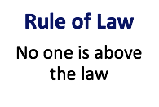
British Values

Slide 12
Do British Values clash?
VS
Individual Liberty
Freedom to express yourselves
Respect and Tolerance
Treating people fairly and equally regardless of who they are or where they are from.
Respect and tolerance is the foundation of our community. Treat others the way you want to be treated.

Slide 13
Safeguarding - Support
Worried about your safety or the safety of anyone else?
Talk to us
Teacher/Tutor
Youth Safety Team
Safeguarding Team
Visit us
Safeguarding & Welfare
Room B208a
Student Hub
Contact us
020 7540 (ext.)
0533 / 0667 / 6968 / 6962
welfare@newvic.ac.uk
We promise to:
Listen
Act
Reassure
Never Judge

Slide 14
Prevent and Safeguarding
Please read the ‘Prevent’ and ‘Safeguarding’ leaflet in silence and independently.
Be ready for a short Google Form Quiz - entered in a prize draw!

Slide 15
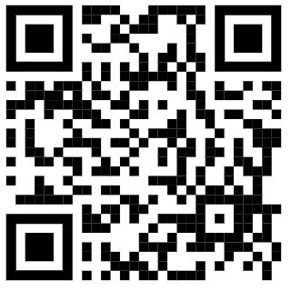
Complete the Safeguarding and British Values Survey - Scan the QR Code!
https://forms.gle/cZ3WYaXBsd6jrJSK7
Complete the Survey and automatically be entered into a PRIZE Voucher draw!
Notes:
https://forms.gle/cZ3WYaXBsd6jrJSK7

Slide 16
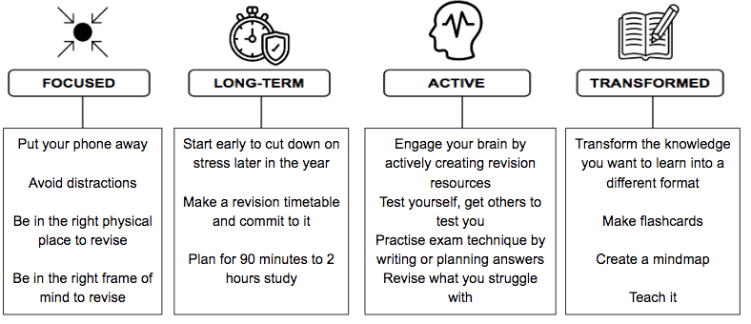
Preparation for success
Independent study must be consistent and continuous

Slide 17
Final Points/Reminders
Keep checking and refreshing your timetables on ProPortal
If you had access arrangements, please speak with your tutor this week.
Student absence email before 9am. Only two authorised per term.
Take part in enrichment and sport activities.
Apply for Free school meals/Bursary (website or student hub)
Be early to be on time.
Always wear your lanyard.

